Slide 1

R-Ladies Lightening Talks R in Industry
Vicki Cocco 10in6 Incorporated – Manufacturing Software
General Dynamics
The Original Cakerie
Pactiv
University of Waterloo
Martial Artist
Two Daughters

Slide 2
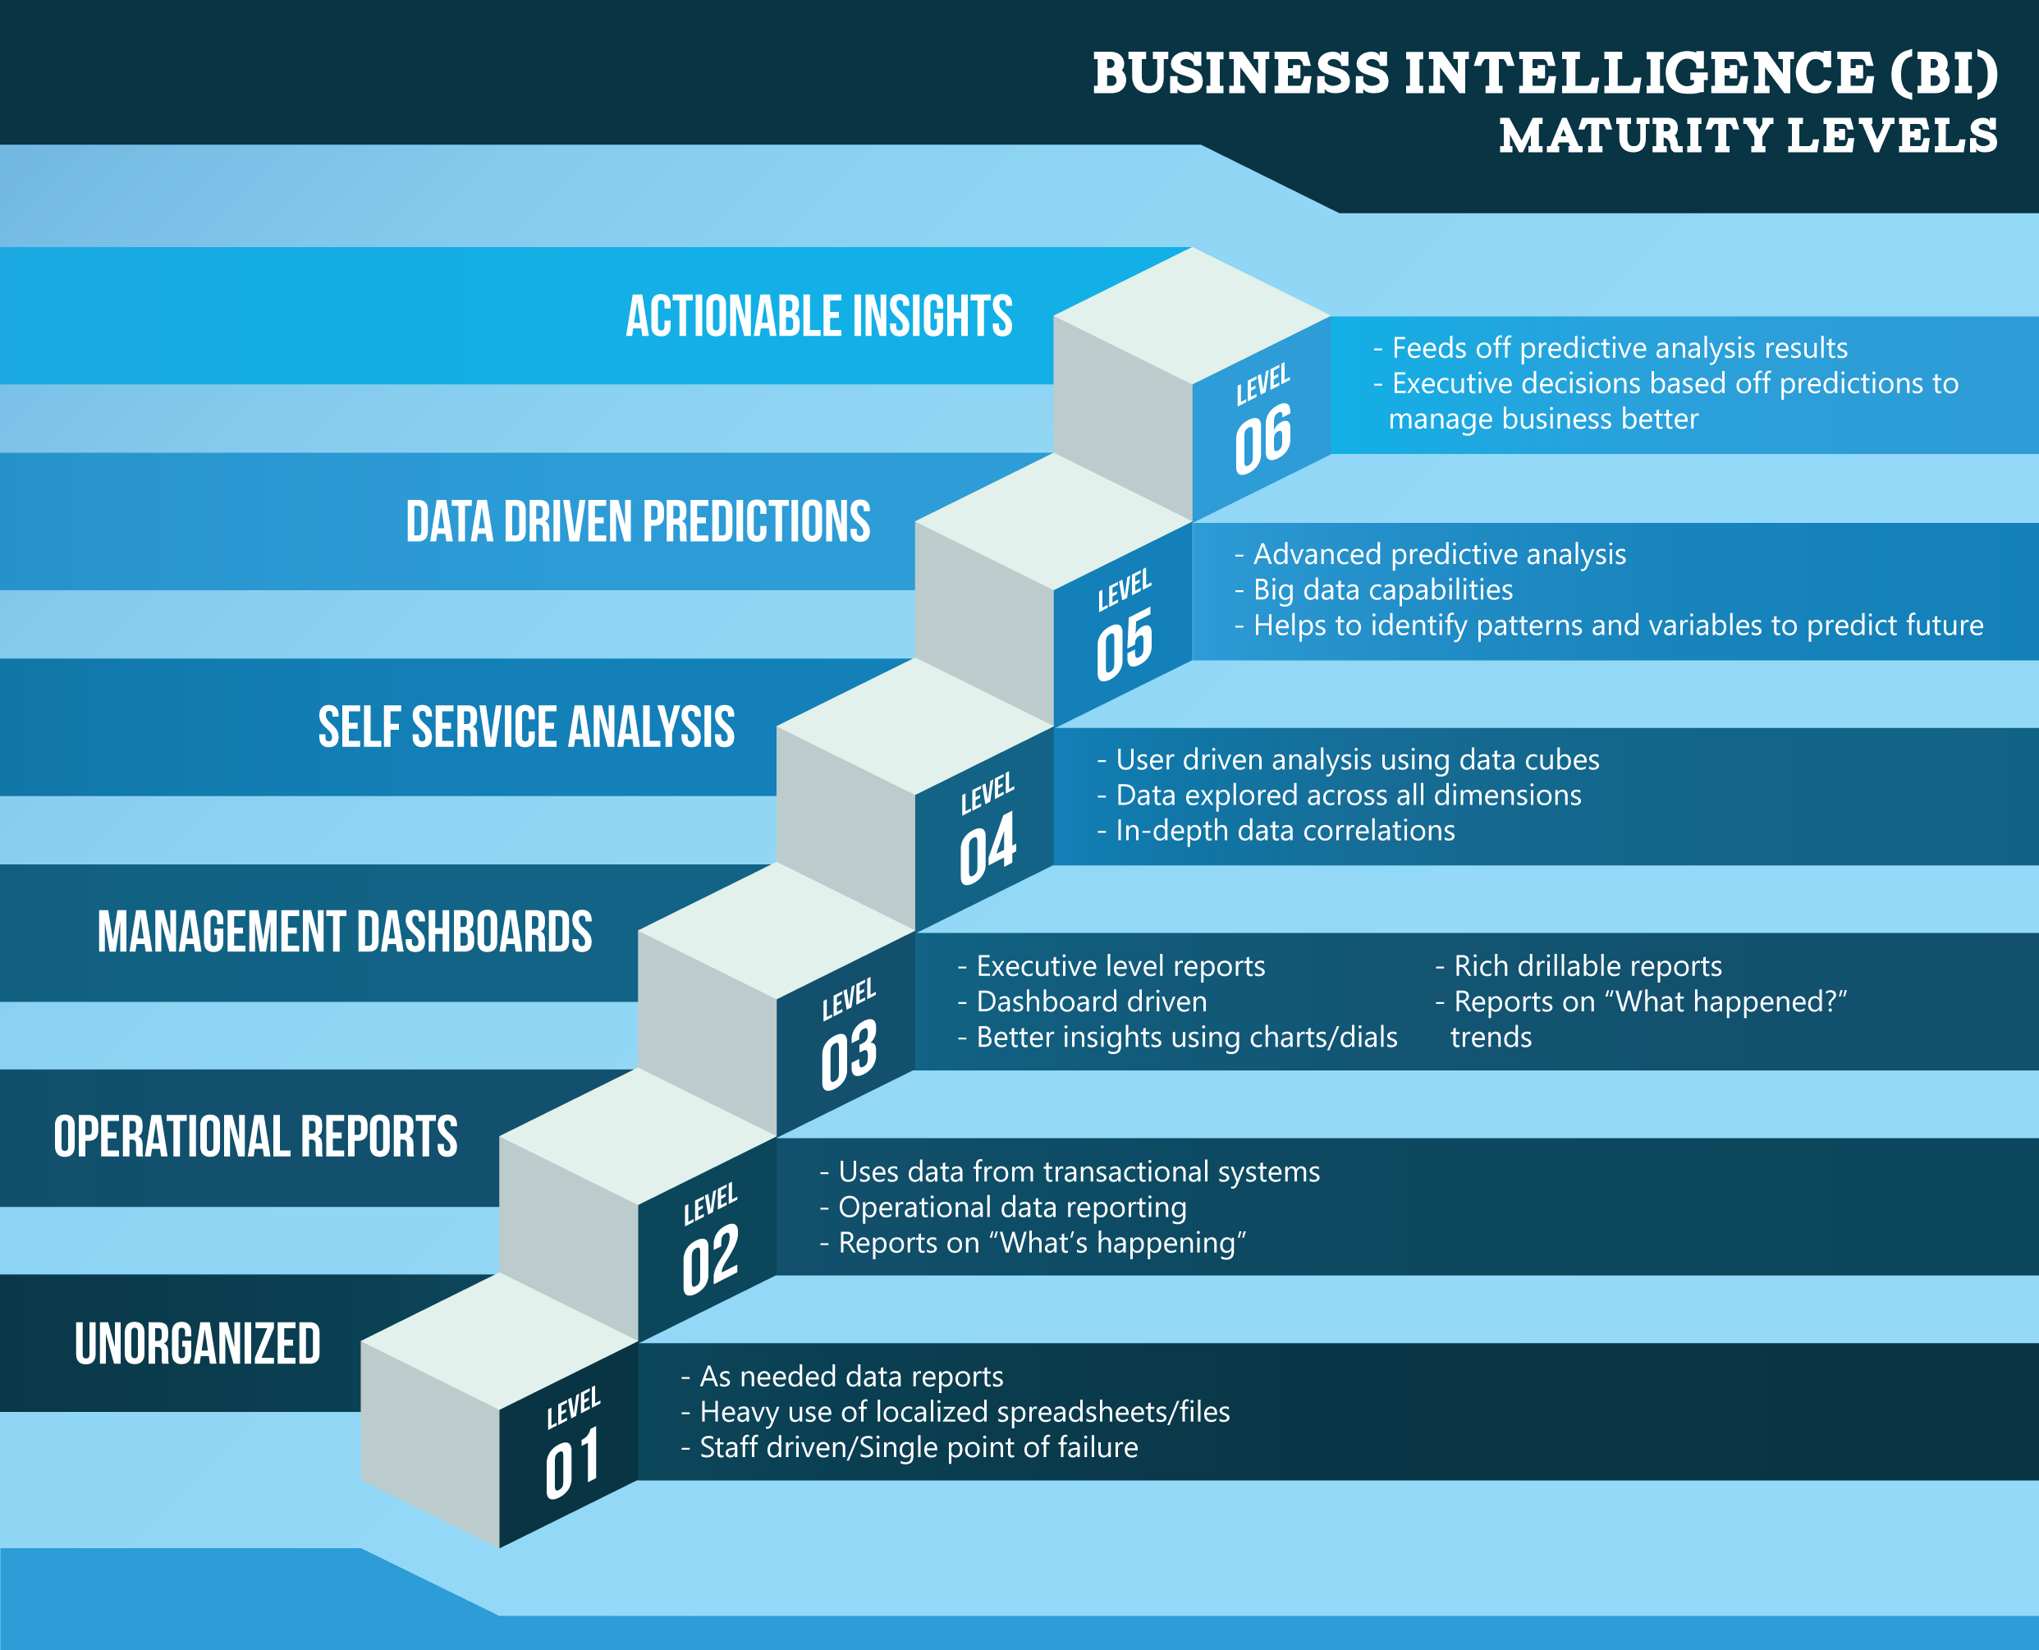
Uses of Data
DATA
ACCOUNTABLE

Slide 3
#WiDS
Women in Data Sciences & Data Science Central
Speech patterns in depression vs bi-polar
Performance and Marking Bias in Education
Hacking patterns of known hackers
Guatemalan Refugee Crisis
Online learning Stats

Slide 4
Coursera / EdX / Microsoft
Fair Trade Education – Mentor for Coursera / Johns Hopkins
Ivey
Data Science - Johns Hopkins University – R Based
Data Sciences – University of Michigan – Python Based
Microsoft Data Sciences Certification – either
Courses on Data Visualization
Data Structures

